Slide 1
LLM Evaluation
By. Prasanna Venkatesh

Slide 2
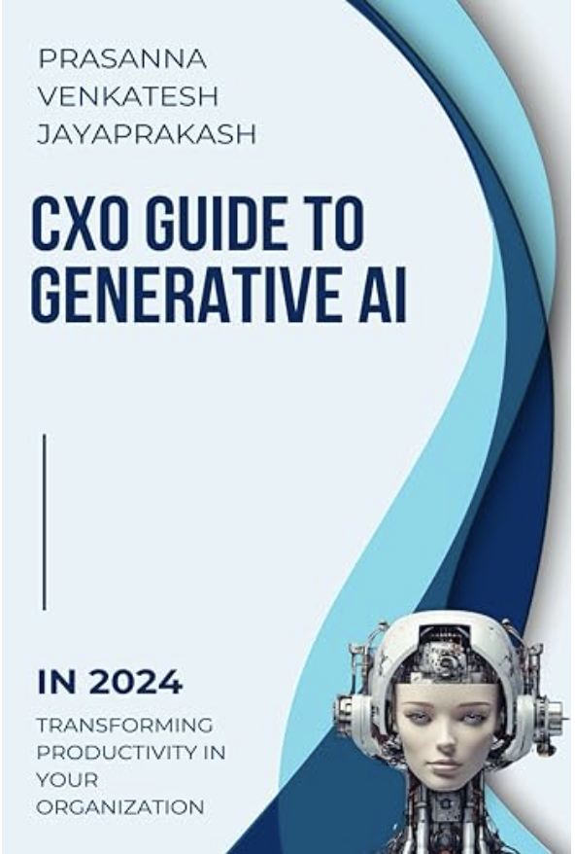
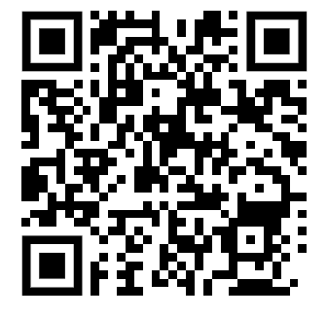
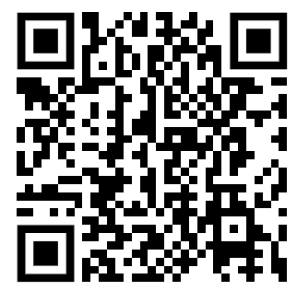
About the Presenter
Prasanna Venkatesh Jayaprakahs – Author and passitionate techologist with 2+ decade IT Experience.
Aspiring CTO.
Linked In:
https://www.linkedin.com/in/prasanna-venkatesh-jayaprakash/
Contact - +91 9840337443
LinkedIn
Book

Slide 3
Large Language Model Evaluation Approaches
LLM Evaluation
LLM Model Evaluation
LLM App Evaluation

Slide 4
LLM Model Evaluation
Intrinsic Evaluation
Extrinsic Evaluation
Human Evaluation
Assessing the internal properties of the language model
Performance of the language model based on its effectiveness in real-world tasks
Assessing aspects that are difficult to quantify automatically

Slide 5
LLM Model Evaluation
Intrinsic Evaluation
Perplexity
Cross-Entropy Loss
BLEU (Bilingual Evaluation Understudy)
RUGE (Recall-Oriented Understudy for Gisting Evaluation)
BERTScore

Slide 6
LLM Model Evaluation -> Intrinsic Evaluation -> Perplexity
Definition:
Perplexity is like a test to see how confused a LLM model is when it tries to predict the next word in a sentence. A lower perplexity score means the model is less confused and performs better.
Example:
Imagine you are playing a word guessing game. If the sentence is
"The cat is on the ____,"
and you have to guess the next word, you might guess "mat."
If the model guesses "mat" correctly most of the time, it has low perplexity.
If it often guesses something wrong, like "moon," it has high perplexity.

Slide 7
LLM Model Evaluation -> Intrinsic Evaluation -> Cross Entropy Loss
Definition:
Cross-Entropy Loss is a way to measure how far off a model’s predictions are from the actual answer. It’s like counting how many wrong guesses the model makes and how bad those guesses are.
Example:
Suppose you are solving a puzzle, and each wrong piece you try to fit adds to your total errors.
If the puzzle has 100 pieces and you make 10 mistakes, your loss is low. But if you make 50 mistakes, your loss is high.
- Cross-Entropy Loss works similarly by adding up all the small mistakes the model makes when predicting words.

Slide 8
LLM Model Evaluation -> Intrinsic Evaluation -> BLEU (Bilingual Evaluation Understudy)
Definition:
BLEU compares pieces of the text (called n-grams) that a model generates with pieces of the text from a reference (correct) text to see how similar they are.
Example:
If you write a sentence: "The dog barks loudly," and the model writes: "The dog barks loudly," the BLEU score is high because all the words match exactly.
If the model writes: "The dog is loud," the BLEU score is lower because only some parts match.

Slide 9
LLM Model Evaluation -> Intrinsic Evaluation -> ROUGE (Recall-Oriented Understudy for Gisting Evaluation)
Definition:
ROUGE measures how much the important parts (n-grams) of a summary match with the important parts of the original text.
Example:
If you read a book about "Jack and the Beanstalk" and your summary says: "Jack climbs a beanstalk and finds a giant," and the original story has those same main ideas, the ROUGE score will be high.
If your summary misses these key points, the ROUGE score will be low.
ROUGE-N and ROUGE-L
ROUGE-1 - is often used to evaluate the grammatical correctness and fluency of generated text.
ROUGE-L - measures the longest common subsequence (LCS) between the candidate text and the reference text.

Slide 10
LLM Model Evaluation -> Intrinsic Evaluation -> BERTScore
Definition:
BERTScore uses a smart model (BERT) to see how similar two sentences are by looking at the meanings of the words, not just the exact words.
Example:
If you have the sentence: "The cat sits on the mat," and another sentence: "The feline rests on the rug," BERTScore will look at the meanings of "cat" and "feline," "sits" and "rests," "mat" and "rug," and see that they are similar. If the meanings match well, the BERTScore is high.

Slide 11
LLM Model Evaluation
Intrinsic Evaluation
Perplexity
Cross-Entropy Loss
BLEU (Bilingual Evaluation Understudy)
RUGE (Recall-Oriented Understudy for Gisting Evaluation)
BERTScore

Slide 12
LLM Model Evaluation
Extrinsic Evaluation
Task-Specific Benchmarks
User Study
SQuAD
GLUE
SuperGLUE

Slide 13
LLM Model Evaluation -> Extrinsic Evaluation -> Task Specific Benchmark SQuAD (Stanford Question Answering Dataset)
Purpose:
How well a model can find answers to questions from a piece of text.
Example:
If you read a story about a boy named Jack who climbs a beanstalk, and then you are asked, "Who climbed the beanstalk?" The model needs to find and say "Jack."

Slide 14
LLM Model Evaluation -> Extrinsic Evaluation -> Task Specific Benchmark GLUE (General Language Understanding Evaluation)
Purpose:
How well a model understands different types of sentences and can figure out things like if a sentence is true, false, or if two sentences mean the same thing.
Example:
If the model is given the sentences "The cat is on the mat" and "The mat has a cat on it," it needs to understand that these two sentences mean the same thing.

Slide 15
LLM Model Evaluation -> Extrinsic Evaluation -> Task Specific Benchmark SuperGLUE (General Language Understanding Evaluation)
Purpose:
It's a harder version of GLUE that checks if the model can do even tougher tasks like figuring out the meaning of more complex sentences.
Example:
If the model is given a sentence like "Despite the rain, the picnic continued," it needs to understand that the picnic kept going even though it was raining.

Slide 16
LLM Model Evaluation
Extrinsic Evaluation
Task-Specific Benchmarks
User Study
SQuAD
GLUE
SuperGLUE

Slide 17
LLM Model Evaluation -> Extrinsic Evaluation -> User Study
Purpose:
Like having a bunch of people try out a computer program to see how well it works. The people give feedback on what they like, what they don’t like, and what could be better
Example:
Imagine your office is testing a new Employee support chatbot that can answer questions about HR and ITServices. The Company asks employees to use the chatbot and then fill out a survey about their experience. Employees might answer questions like:
Did the chatbot understand your questions?
Were the answers helpful?
Was it easy to use the chatbot?
Based on the Employees ' answers, the company can figure out if the chatbot is good at helping with HR and IT Services or if it needs improvements.

Slide 18
Large Language Model Evaluation Approaches
LLM Evaluation
LLM Model Evaluation
LLM App Evaluation
Intrinsic Evaluation
Extrinsic Evaluation
Human Evaluation
Perplexity
Cross-Entropy Loss
BLEU
RUGE
BERTScore
Task-Specific Benchmarks
SQuAD
GLUE
SuperGLUE
User Study

Slide 19
Large Language Model Evaluation Approaches
LLM Evaluation
LLM App Evaluation
Content Generation Tools
Question Answering Systems
Translation Services
Summarization Tools
Sentiment Analysis Tools
Ethical and Safety Evaluations

Slide 20
Q&A
Prasanna Venkatesh Jayaprakahs – Author and passitionate techologist with 2+ decade IT Experience.
Aspiring CTO.
Linked In:
https://www.linkedin.com/in/prasanna-venkatesh-jayaprakash/
Contact - +91 9840337443
LinkedIn
Book

